Slide 1
Laptop Price Prediction for SmartTech Co.
Mounika P

Slide 2
AGENDA
Overview
Data and Libraries
Data Cleaning & EDA
Building a Model
Model Performance

Slide 3
OVERVIEW
This project involves predicting Laptop Prices for the company of SmartTech Co. using ML algorithms
This project uses data existing data from the smartTech Co. company
Building a model for predicting laptop prices

Slide 4
DATA & LIBRARIES
Libraries
Purpose
pandas
numpy
matplotlib/seaborn
sklearn
Data manipulation and pre-processing
Numerical Operations
Data Visualization
Machine learning models and data pre-processing

Slide 5
DATA & LIBRARIES
Dataset: Laptop price dataset
Rows: 1,303 rows and 13 columns
Columns include:
Company. TypeName,
Inches, Screen Resolution,
CPU, RAM, Memory,
GPU, Operating Systems, Price etc

Slide 6
DATA CLEANING & EDA
Removed Irrelevant columns (e.g., unnamed: 0.1, Unnamed:0)
Converted memory/storage fields into uniform format(e.g., GB,TB)
Checked for missing values and handled them appropriately.
Fixed inconsistent string formatting (e.g., CPU names, OS names)
Extracted numerical values from text (e.g., ‘8GB’→8)
Parsed complex features like ‘Screen Resolution 'into multiple new columns (e.g., touchscreen, resolution)
Encoded Categorical variables using Label Encoding or One-Hot Encoding
Validated all types and formats before model building

Slide 7
DATA CLEANING & EDA
Using Regular Expressions
IPS Panel Retina Display TouchScreen 2560x 1600
IPS Panel Retina Display
TouchScreen
2560x 1600
Intel Core i5 2.3GHz
Intel Core i5
2.3GHz

Slide 8
DATA CLEANING & EDA
‘Screenresolution’ can give as ‘display_type’, ‘resolution’ & ‘touchscreen’
‘cpu’ can be sepearted to form ‘cpu’ and ‘clockspeed’
‘memory’ can be separated to form ‘memory’ and ‘memory_type’
‘gpu’ can be sepearated to get ‘gpu_company’
A new dataframe ‘df_clean’ was made by removing obsolete columns from the ‘df’ dataframe.

Slide 9
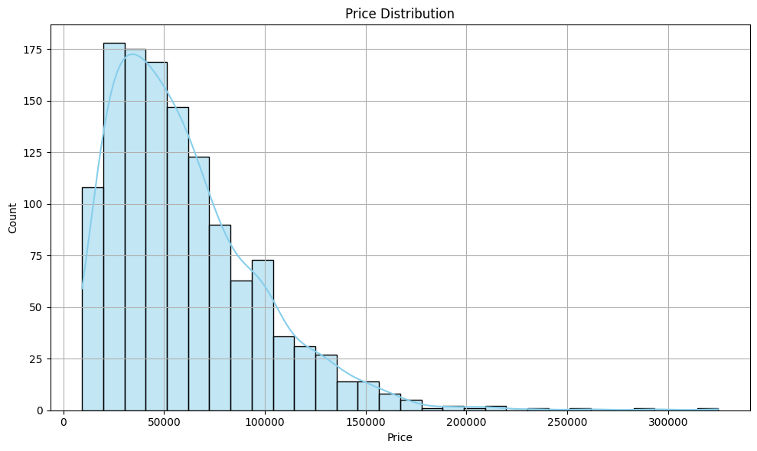
DATA CLEANING & EDA
Prices were positively skewed with a right tail

Slide 10
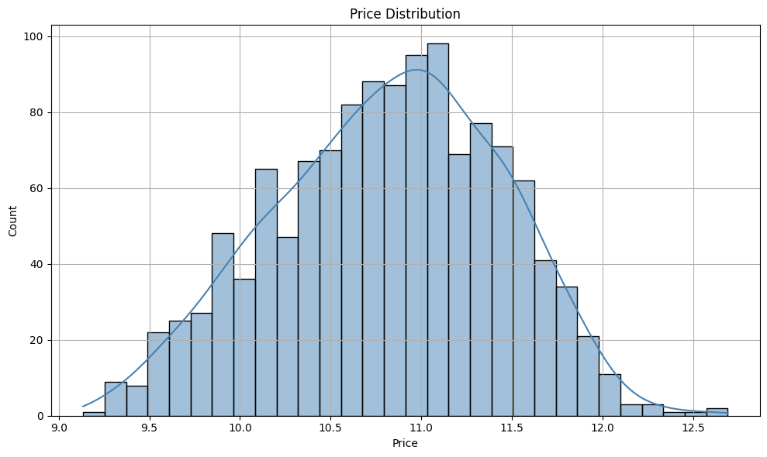
DATA CLEANING & EDA
Prices were positively skewed with a right tail
Log transformation allows for a normally distributed data

Slide 11
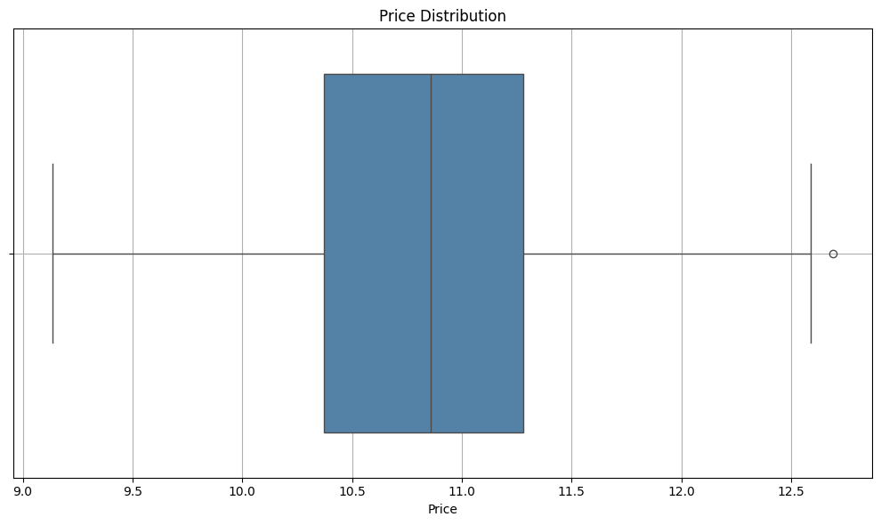
DATA CLEANING & EDA
Prices after log transformation had outliers which were removed

Slide 12
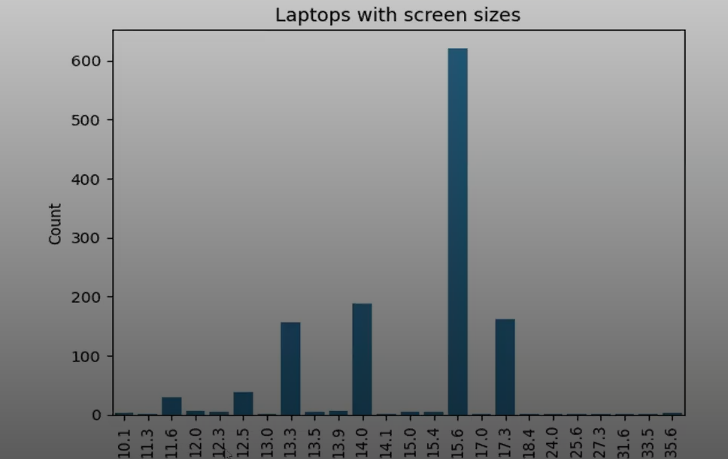
DATA CLEANING & EDA
Only four screen sizes makes up 96.06%of laptops

Slide 13
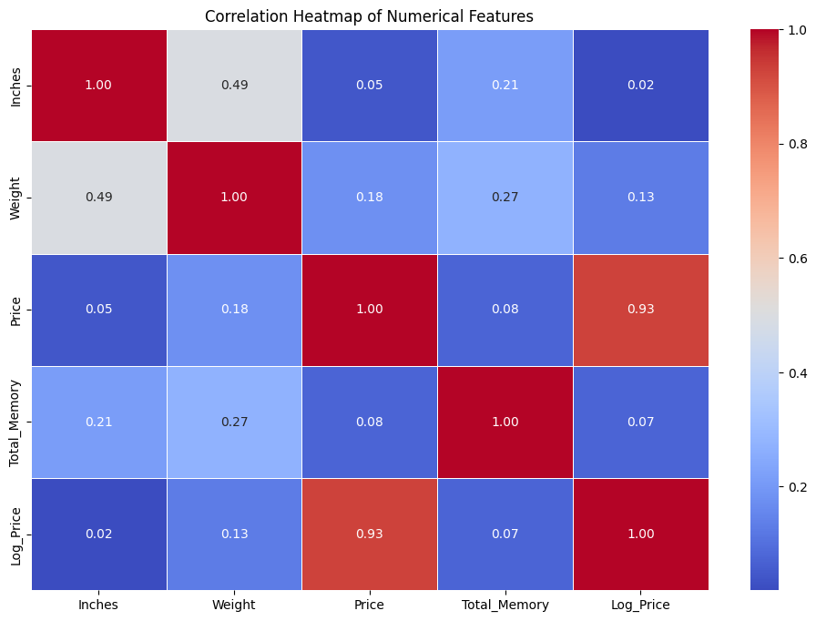
DATA CLEANING & EDA
Parameters like ram_gb, cpu_gz have a strong relationship with price

Slide 14
BUILDING MODEL
We have gone through different parameters of the data now it’s time to put that to building a model.
I’m going to build 2 models
Random Forest Regressor
Linear Regression Model
And compare them to find the best model

Slide 15
MODEL PERFORMANCE
Random Forest Regressor
Linear Regression Model
The Random Forest Regressor model produced an accuracy of 88% for the dataset.
The Random Forest Regressor model produced an RMSE of 17986.37
The Linear Regression model produced an accuracy of 85% for the dataset.
The Linear Regression model produced an RMSE of 20326.65

Slide 16
WHICH MODEL TO CHOOSE
I would recommend clients to choose Random Forest Regression as it explains the features much better than Linear Regression

